Slide 1



Project Synopsis Presentation On
“A BIOMETRIC BASED SMART ATM"
Guided By:
Dr. Gayatri M Phade
Designation:
HEAD OF DEPT.
Dept. of E & TC Engg.
Presented By:
NAKUL PRAVIN TIWARI [60]
RAMESHWAR VINOD KHAMGAONKAR [30]
SHRUTI BALASAHEB WALZADE [61]
Academic Year
(2023 – 24)
Date: 30/5/2023
Department of Electronics & Telecommunication
Sandip Institute of Technology and Research Centre, Nashik.

Slide 2



Contents
PROBLEM STATEMENT
INTRODUCTION
AIM & OBJECTIVE OF THE PROJECT
LITERATURE SURVEY
BLOCK DIAGRAM
ADVANTAGES & LIMITATIONS
CONCLUSION & FUTURE SCOPE
REFERENCES

Slide 3
Problem Statement
In ATM, authentication is performed through ATM PIN given to the customer and a Pin Identification Number known to user. If this information is matches then anyone can withdraw cash from customers account. There are several techniques by which criminals can get this information from user. Some techniques like Skimming, Lebanese Loop or Lost/Stolen Cards.
And as we know this frauds mostly happen to senior citizens, house makers etc. This people are the main target of the criminals.

Slide 4
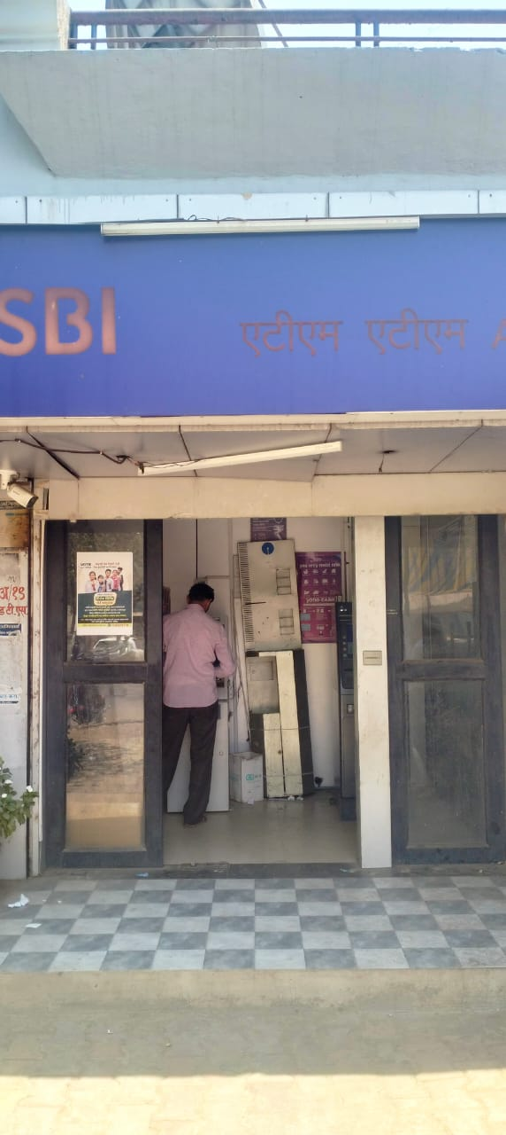
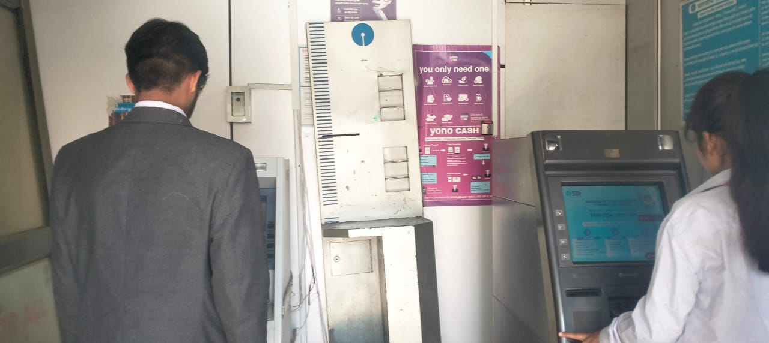
Site Survey
fig,. Site Survey at SBI ATM, Ashoknagar Satpur Nashik

Slide 5
Site Survey
During our visit to an ATM located in Ashoknagar, Satpur, Nashik, we observed several concerning issues. The doors of the ATM were broken, posing a significant security risk. The overall security was notably low, with no visible security personnel or surveillance systems in place. This lack of security creates an environment where various malpractices, such as unauthorized access and potential theft, can easily occur. The condition of the ATM and its surroundings raise serious concerns about the safety and integrity of financial transactions at this location.
The ATM device lacked any security systems, making it highly vulnerable to unauthorized activities. The absence of proper doors and surveillance meant that skimming devices could easily be installed without detection. Additionally, there was no privacy for users while withdrawing or depositing money, exposing them to potential onlookers and increasing the risk of financial fraud. The overall condition of the ATM raises serious concerns about the safety and security of transactions at this location.

Slide 6
Problem Statement- Video
Project Video in Phone

Slide 7
Introduction
ATM is an automated teller machine which is a computerized telecommunication device that provides customer with access to financial transactions in public space without the need for human clerk or bank teller. In this paper we proposed to add more security to current ATM system.
By using biometric authentication and GSM technology, we can overcome many of the flaws introduced by our current ATM system. In modern world, money is required at any time or anywhere for travelling, shopping and health emergencies we need to carry money.
It increases the risk of robbery at any instant, where bank is the safest place to keep our money. It provides automated teller machine (ATM) which can provide money at any time at any location.
ATM is the easiest way to get the money. So to increase the further security we are motivated to increase user security by adding secondary stage of prevention to the existing security system by using biometric authentication and GSM module to generate OTP and verify whether the specified person is using. User will only be allowed transaction only if OTP is received by specified user.
In current scenario the way banking and transaction system is changing in the world, the validation,

Slide 8
Introduction
Authentication and verification has always been the part to worry about security and confidentiality of the consumers. In rapid changing world it is not easy to maintain integrity and authenticity of a persons.
To prevent the frauds we need some foolproof security solutions which we can use along with current available technology.
We can use Biometric authentication, automatic door lock system

Slide 9
Aim & Objective Of Project Work
Aim:
To Purpose a biometric based ATM machine to increase security and to eliminate the frauds done by the criminals.
Objectives:
To build a ATM which uses voice interactive to do transactions
To eliminate the risk of various malpractices done by criminals while doing transactions
To increase the security of the user while doing various transactions
To develop an ATM for illiterate people

Slide 10
Summary Of Literature Survey
Sr. No. | Title of Paper | Author’s Name | Publication Year & Details | Advantages / Salient Remarks | Drawback / Future scope
1. | Biometric authentications to control ATM theft | Manoj V,Moulishankar R, Sasipriya S, Usha Devi E , Devika | 2023 | Authentication done with the help of biometric . | There should be an option user can also have a two factor authentication
2. | Cardless ATM system: | Ahmad Tasnim Siddiqui | 2017 | Voice recognised ATM. | Biometric should have been used.

Slide 11
Summary Of Literature Survey
Sr. No. | Title of Paper | Author’s Name | Publication Year & Details | Advantages / Salient Remarks | Drawback / Future scope
3. | A Biometric based ATM Security System using RFID & GSM Technology | S.Naga Gowri ,R.Durga Devi P.Gowshalya | 2016 | OTP SYSTEM used for security purpose. | Various malpractices can be done.
Outcome- There is a need to develop a robust ATM system which will help us reduce the frauds and can be used by illiterate people, senior citizens or home-makers.

Slide 12
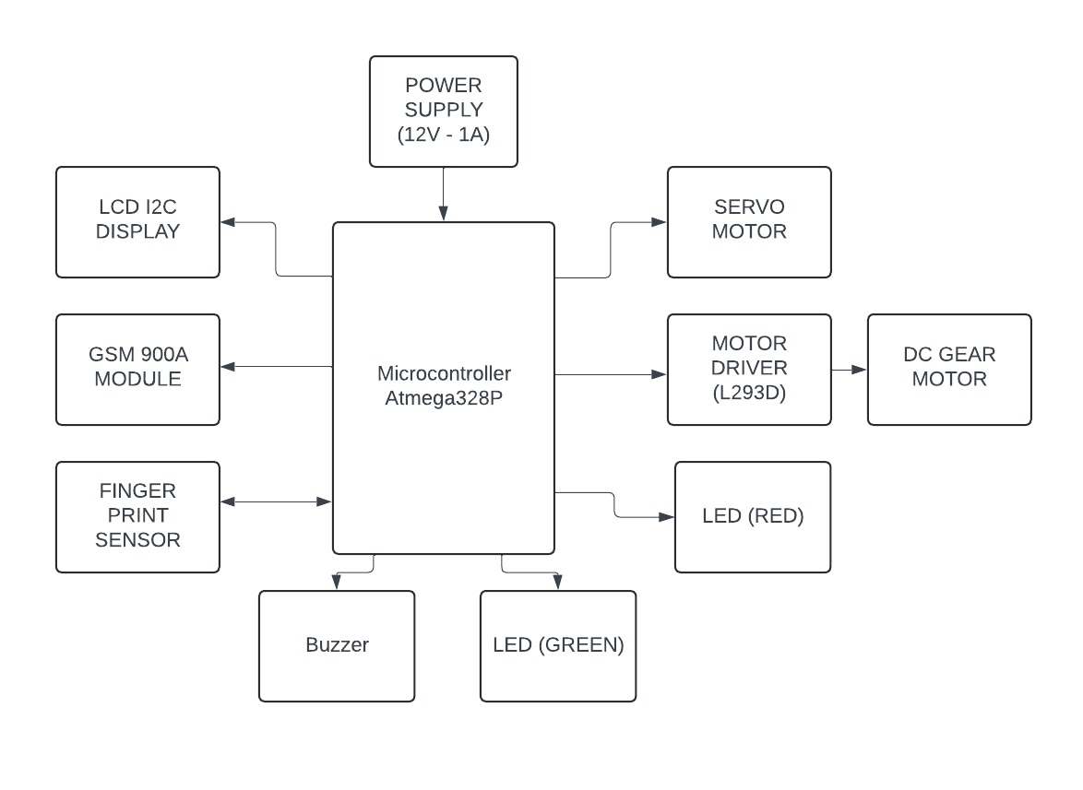
System Block Diagram
Fig. System Block Dig

Slide 13
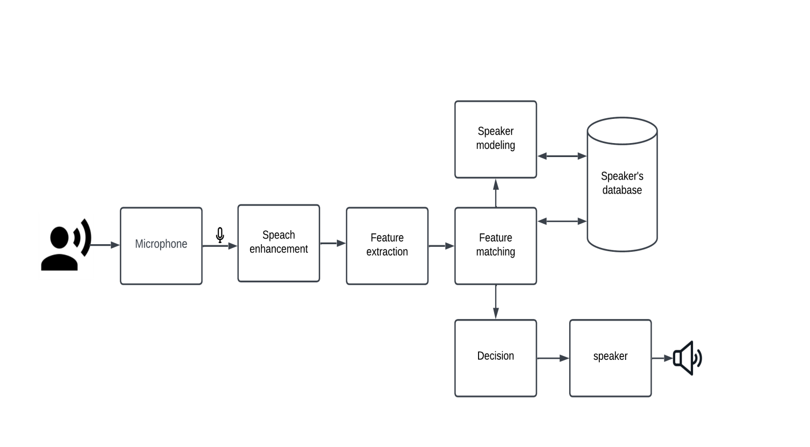
Voice Recognition Block Diagram
Fig. Block Dig of Jarvis
14

Slide 14
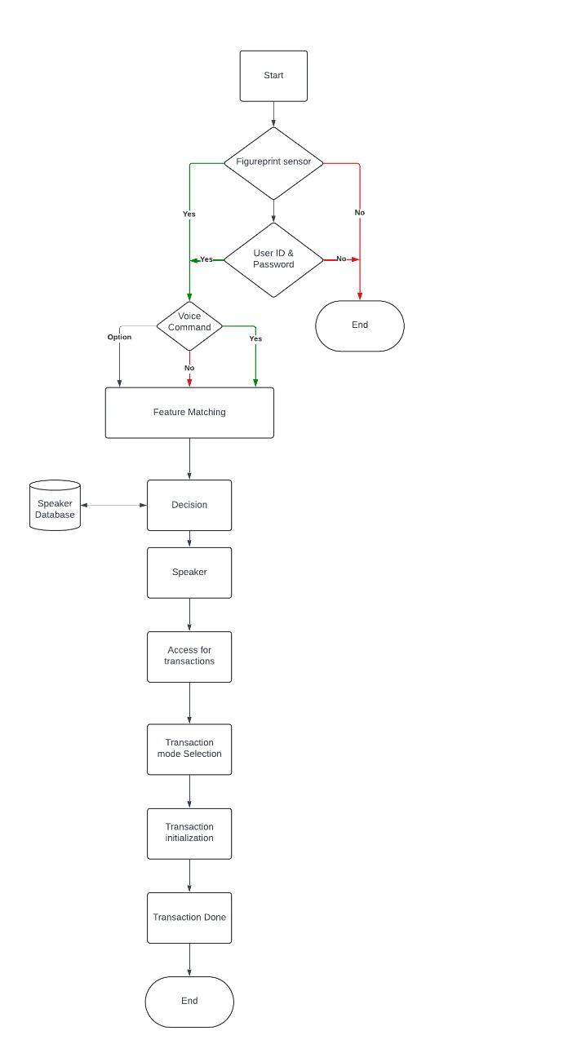
Flowchart
fig. Flowchart of System

Slide 15
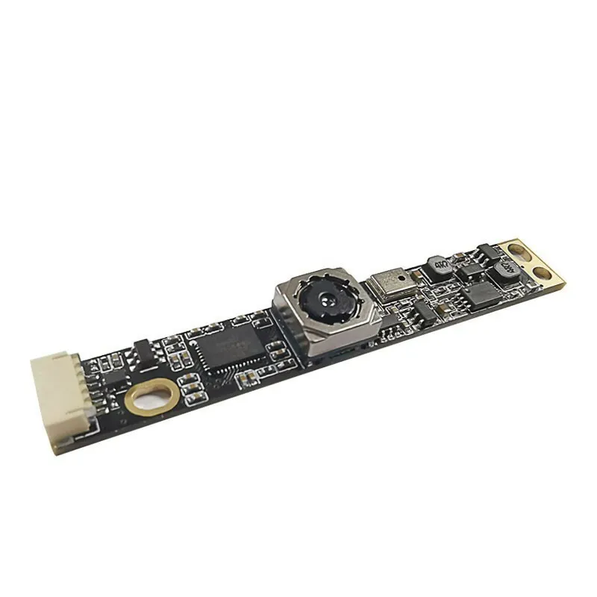
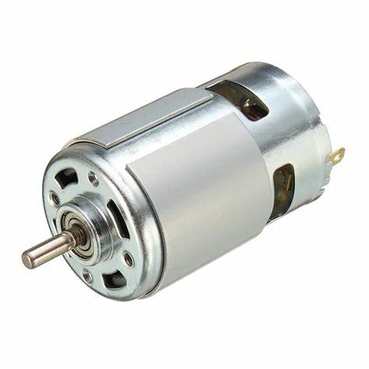
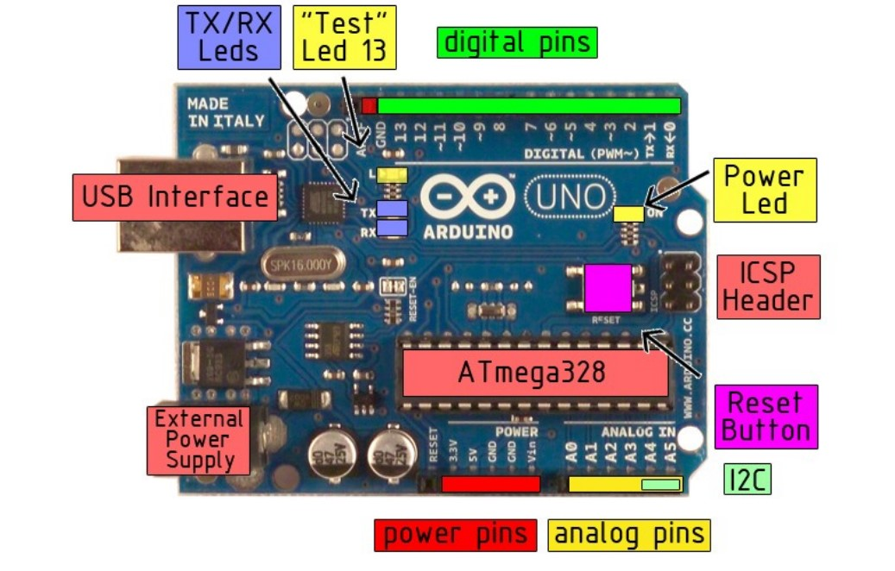
Algorithm / Methodology Used
Arduino Uno R3
Laptop Camera
Purpose : Acts as the main controller to interface and manage all components. It reads inputs from sensors (like the fingerprint sensor and camera) and controls outputs (such as the motor driver, servo motor, LEDs, buzzer, and LCD display).
Purpose :The camera can be used for face detection or motion detection to ensure that a person is present and to trigger certain actions or alerts. The Arduino can interface with the camera using a connected laptop running software for image processing and detection. This adds an extra layer of security and functionality to the system.

Slide 16
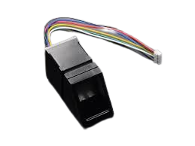
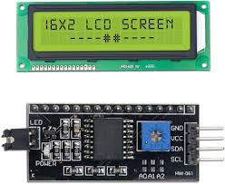
Algorithm / Methodology Used
Fingerprint Sensor
16*2 LCD Display
Purpose : Provides authentication to verify user identity. It ensures that only authorized individuals can access the system. It scans and matches fingerprints against stored data.
Purpose : Displays relevant information to the user. It shows system status, instructions, transaction details, and alerts, ensuring the user is informed about the current operation and system state.

Slide 17
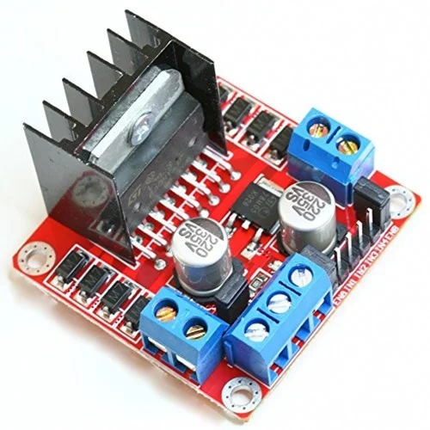
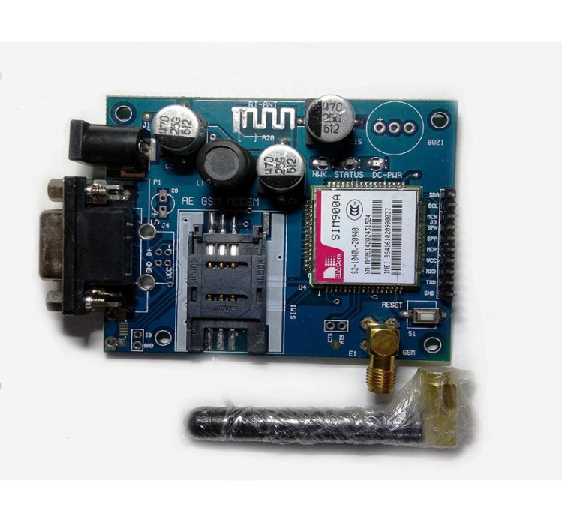
Algorithm / Methodology Used
GSM Module
Motor Driver
Purpose: Sends SMS alerts to designated contacts such as the hospital and police station. This module can communicate over the GSM network, sending text messages to predefined numbers in case of specific events or emergencies.
Purpose: Controls the direction and speed of the DC gear motor. This dual H-bridge motor driver can control two DC motors or one stepper motor, enabling forward and reverse operations for the DC gear motor

Slide 18
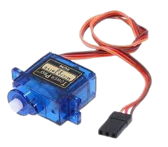
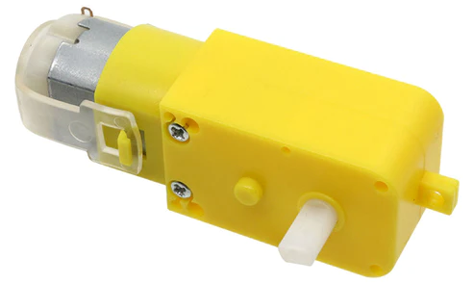
Algorithm / Methodology Used
Servo Motor
Dc Motor Pump
Purpose: Manages the door mechanism for opening and closing. The servo motor rotates to a specific angle, controlled by the Arduino, to physically open or close a door, providing secure access.
Purpose: Handles physical transactions like money withdrawal and deposit. When powered in forward mode, it performs a withdrawal operation, and in reverse mode, it performs a deposit operation, controlled by the L293D motor driver.

Slide 19
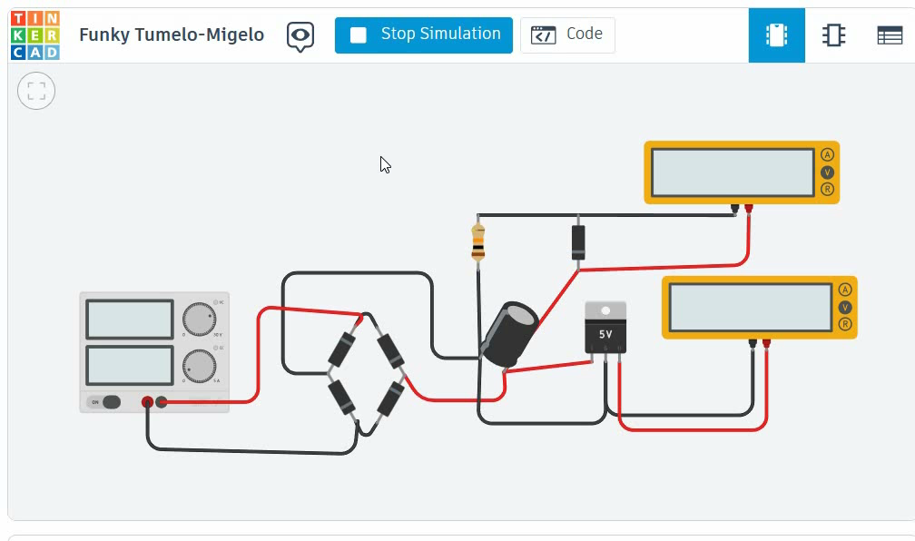
Power Supply Design
Video.1. Simulation of Power Supply on Tinkercad (https://www.tinkercad.com/things/dDdRLbsnyEc-funky-tumelo-migelo?sharecode=FQh_ZUwp-UyJJlTW6bJ7aOeykg5u3aN_YvAlYyhbjiE)

Slide 20
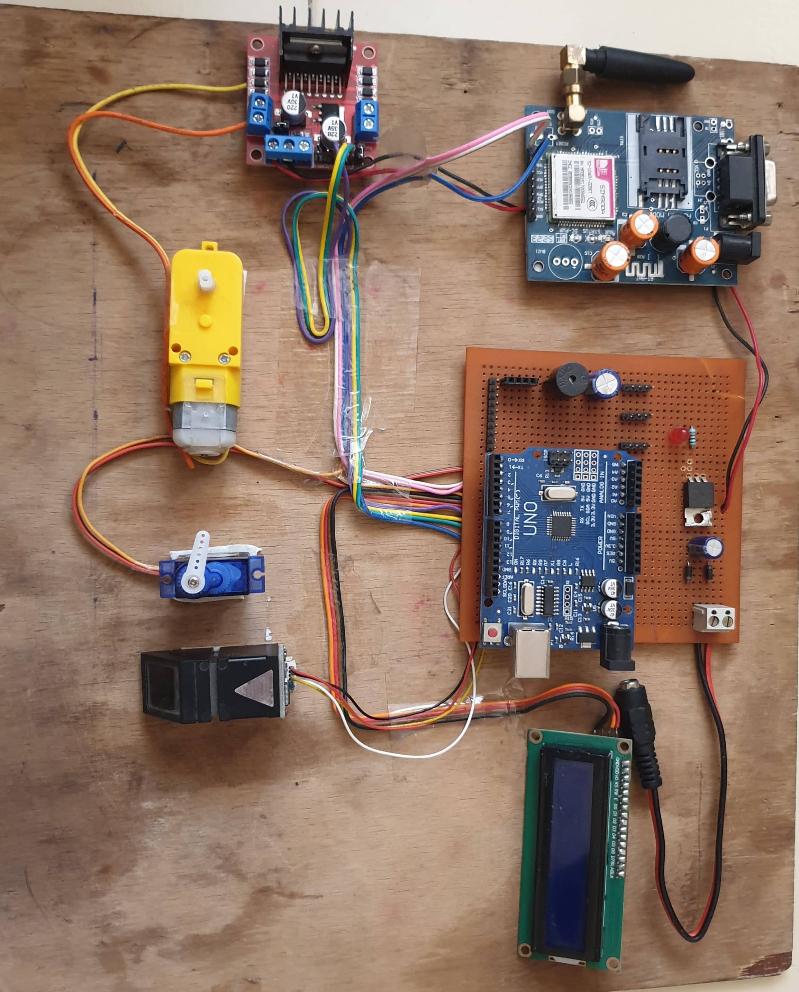
Project Implementation
Fig. Project Implementation

Slide 21
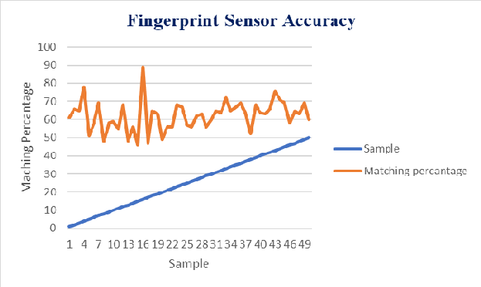
Fingerprint Accuracy
Fig. Accuracy of fingerprint sensor

Slide 22
Fingerprint Accuracy
Test no | Digital Value | Matching Percentage
1 | 245 | 88%
2 | 135 | 94%
3 | 189 | 80%
4 | 375 | 96%
5 | 287 | 90%
6 | 332 | 95%
7 | 260 | 82%
Table 1. Fingerprint sensor Matching Percentage
The "Digital Value" typically represents the output of the fingerprint sensor. It's a numerical value that corresponds to the characteristics of the fingerprint being scanned. This value is obtained directly from the sensor during testing.
The "Matching Percentage" indicates the similarity between the fingerprint being tested and a reference fingerprint. This percentage is calculated using an algorithm that compares the features of the scanned fingerprint with those of the reference fingerprint. The higher the percentage, the closer the match between the two fingerprints.

Slide 23
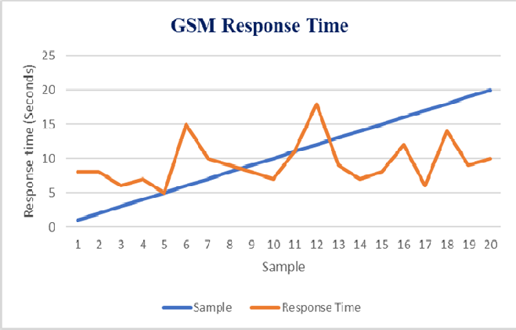
Gsm Module Accuracy
Fig. Accuracy of Gsm Module

Slide 24
Gsm Module Accuracy
Location | Condition | Signal Strength
Ashoknagar, Nashik | Clear Sky | -75
 | Indoor | -85
 | Near Window | -80
Shivajinagar, Nashik | Clear Sky | -80
 | Indoor | -90
 | Near Window | -85
Bardan Phata, Nashik | Clear Sky | -85
 | Indoor | -85
 | Near Window | -95
Table 4.2 GSM Signal Strength
1. Received Signal Strength Indication (RSSI): The GSM module typically reports signal strength in terms of Received Signal Strength Indication (RSSI), measured in dBm.
2. Conversion from RSSI to dBm: RSSI values are typically provided by the GSM module. These values can be directly used as dBm, but the conversion may differ depending on the module's specifications. In some cases, you might need to convert RSSI values to dBm using a specific formula provided in the module's documentation.

Slide 25
Components Used
Sr. No. | Name of Component | Price per Quantity | Quantity | Cost
1. | Arduino UNO | ₹550 | 1 | ₹550
2. | Fingerprint Sensor | ₹1200 | 1 | ₹1200
3. | Gsm 900A | ₹700 | 1 | ₹700
4. | Motor Driver | ₹120 | 1 | ₹120
5. | Dc Gear Motor | ₹100 | 1 | ₹100
6. | Servo Motor | ₹75 | 1 | ₹75
7. | Lcd Display I2C | ₹150 | 1 | ₹300
8. | Buzzer | ₹10 | 1 | ₹10
9. | Led (Green,Red) | ₹10 | 2 | ₹10
Total Cost |  |  |  | ₹3065
Table 3. Components Used

Slide 26
Advantages
A smart ATM with biometric authentication, voice recognition assistance for transactions, and various safety features offers several advantages compared to traditional ATMs. Here are some of the key benefits:
Enhanced Security: Biometric authentication methods such as fingerprint provide a higher level of security compared to traditional PINs and cards.
Reduced Fraud: Biometrics and voice recognition make it difficult for criminals to steal or guess passwords and PINs
Accessibility and Inclusivity: Voice recognition assistance makes ATM transactions more accessible for people with disabilities
Convenience: Users don't need to carry physical cards, remember PINs

Slide 27
Applications
Smart ATMs with biometric authentication, voice recognition assistance for transactions, and various safety features can be applied in a range of scenarios and industries to enhance security, convenience, and accessibility. Here are some of its applications-
1)Retail
2)Educational Institutions
3)Remote and High-Risk Environments
4) Reduced Dependency on Pin
5)Personalized Banking Experience
* Smart ATMs equipped with biometric authentication, voice recognition, and enhanced safety features can be applied across various industries to streamline transactions, improve security, and offer more convenient and accessible services to customers and users.

Slide 28
FUTURE SCOPE
QR code recognition.
scanning of microchip on ATM card
Releasing chloroform via air conditioner during theft whenever illegal moments are detected.
If the person who can’t speak will perform transaction by the use of actions that webcam will detect and AI will respond.
Through one ATM we can withdraw cash from account of another bank. Such interbank transactions can be implemented.
For this one needs to maintain separate database of all banks and in ATM option of such all banks must be given to user.
User will select one option and then all transactions from that account are performed [3].
Fingerprint image encryption can be developed and collected fingerprints can be stored in central database.
A new sensor must be designed to remove the touched based concept to solve sensor issue by capturing image from distance.

Slide 29
Conclusion
The problem of ATM theft and misuse of ATM card has become a major source problem in the society. From the above conceptual model it has been cleared that biometric ATM system is highly secured as it provides authentication. Multimode biometric can be implemented to enhance the security level of the ATM organization[4]. This system identifies a high level model for the modification of existing ATM system by updating biometric authentication, automatic door lock, AI based voice recognition which will ensure an absolute security to the system

Slide 30
REFERENCES
1. Multi authentication ATM theft prevention using ibeacon- Manoj V,Moulishankar R, Sasipriya S, Usha Devi E , Devika t.UG student knowledge institute of technology,salem.
2. Biometric authentications to control ATM theft” Ahmad Tasnim Siddiqui,College of computers and IT Taif University,Kingdom of Saudi Arabia.
3. ATM security using fingerprint authentication and OTP-Aruna r, Sudha v, Shruthi G,Usha Rani R, Sushma V ,Department of electronics and telecommunication Engineering, Shri Sairam College of Engineering,Anekal,Banglore.
4. A Biometric based ATM Security System using RFID & GSM Technology S.Naga Gowri1 | R.Durga Devi2 | P.Gowshalya3 1,2,3UG Scholars, Department of ECE,Roever Engineering College, Perambalur, India.
5. www.googlescholar.com
6. www.ieeexplore.com

Slide 31
Thank You !!
Questions if any…
Department of Electronics & Telecommunication
Sandip Institute of Technology and Research Centre, Nashik.

